Slide 1




[20 mins talk] Monte Carlo Simulation for A/B Testing Frameworks Validation

Slide 2
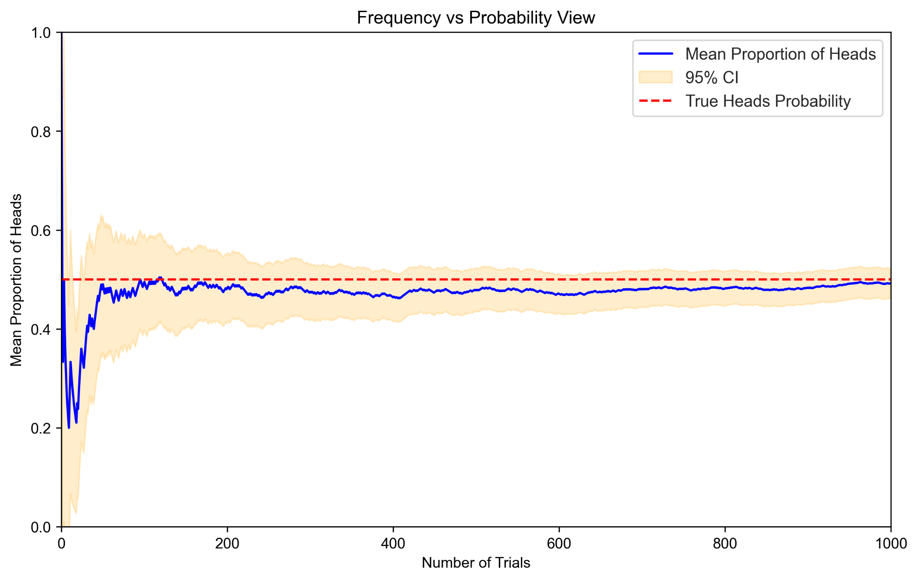
Frequentist view on probability and AB testing
Probability as the limit of the expected frequency
P-value is the probability of observing this or more extreme results if H0 is true
CI means if we could repeat the experiment many times, 1-a% of constructed intervals should capture the true parameter
Tossing a fair coin

Slide 3
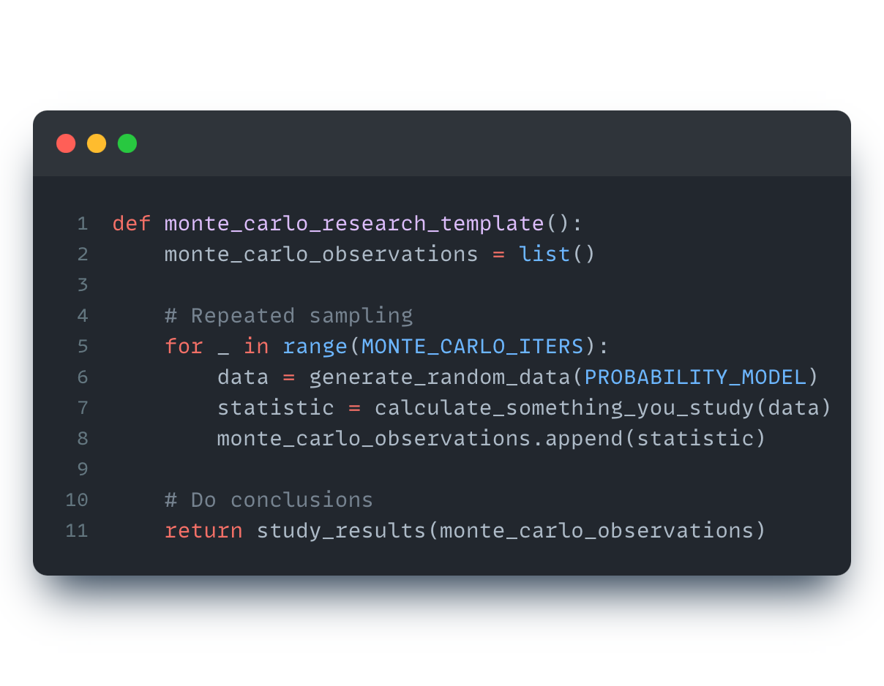
Monte Carlo intuition
Monte Carlo methods vary, but tend to follow a particular pattern:
Define a domain of possible inputs
Generate inputs randomly from a probability distribution over the domain
Perform computation and aggregate the results
AB analysis based on repeatability, frequency, H0 model
MC performs repeated simulation and analyse the results

Slide 4
AB framework development + Monte Carlo = ❤️
A/B analysis based on:
Repeatability
Frequency
H0 model
Monte Carlo performs:
Repeated simulation
Aggregated Conclusions

Slide 5
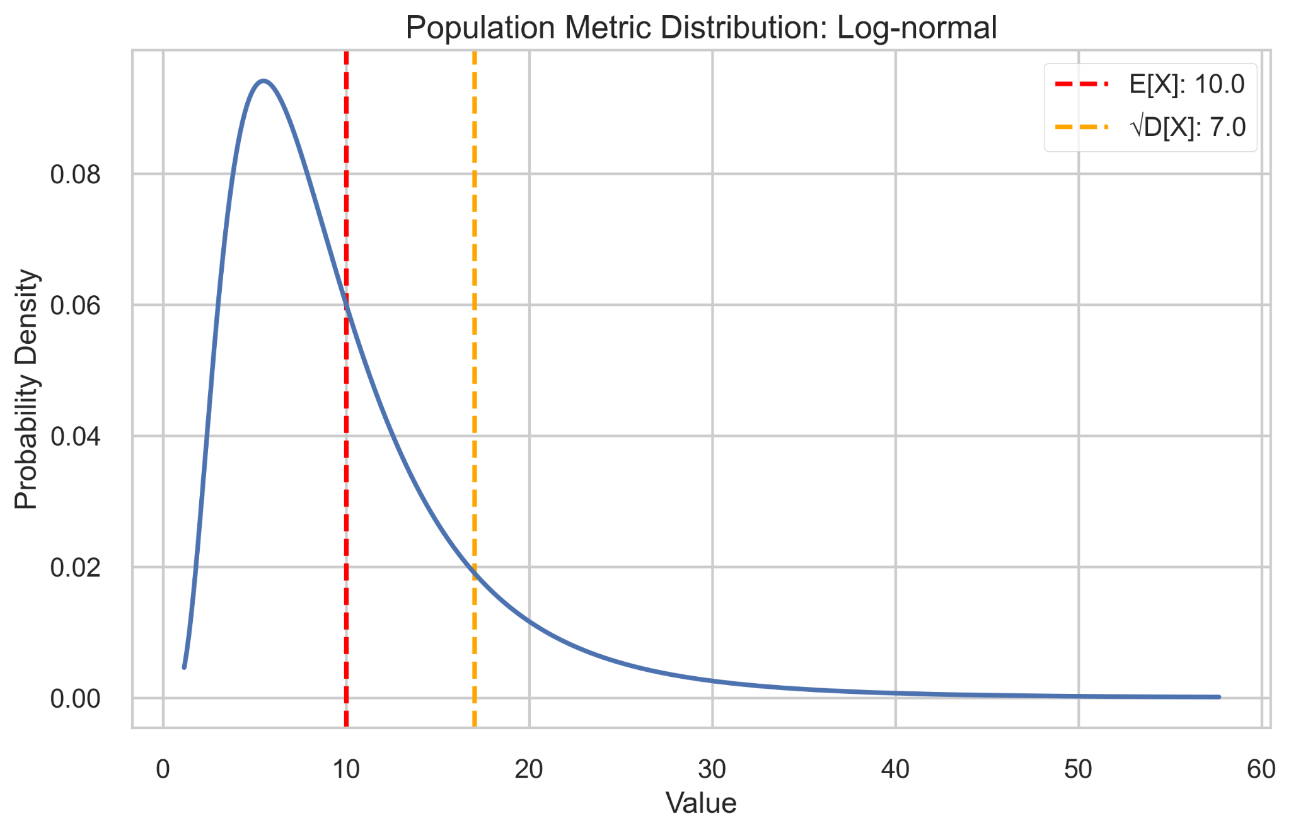
Let’s learn how to use MC on one particular instance
* Not all studies require accurate modeling ** You can model based on historical data
*** In reality we may want to have a bunch of models for different scenarios

Slide 6
What does A/B framework validation include?
We may want to check a lot of things:
Sampling method
Sample transformations methods
Statistical Criteria False Positive Rate
Statistical Criteria Power
MHT corrections and other hacks
… almost any technique you want to use
Our framework gives:
correct,
representative
and sensitive
estimations of the treatment effect
→

Slide 7
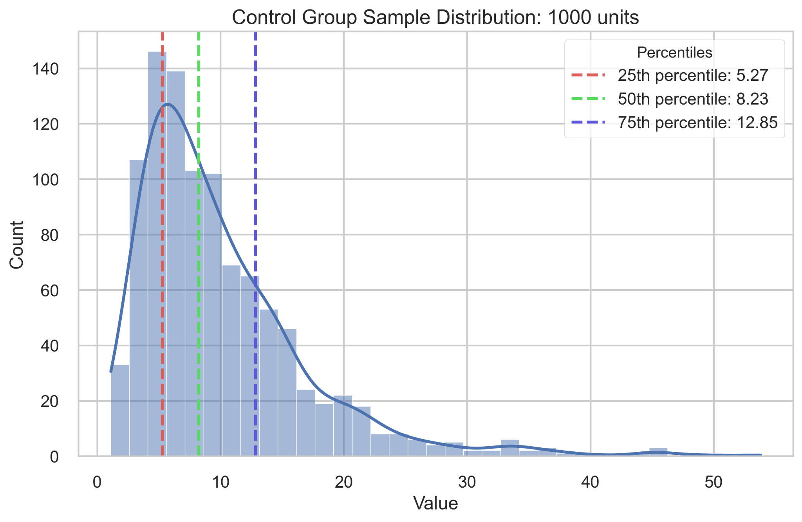
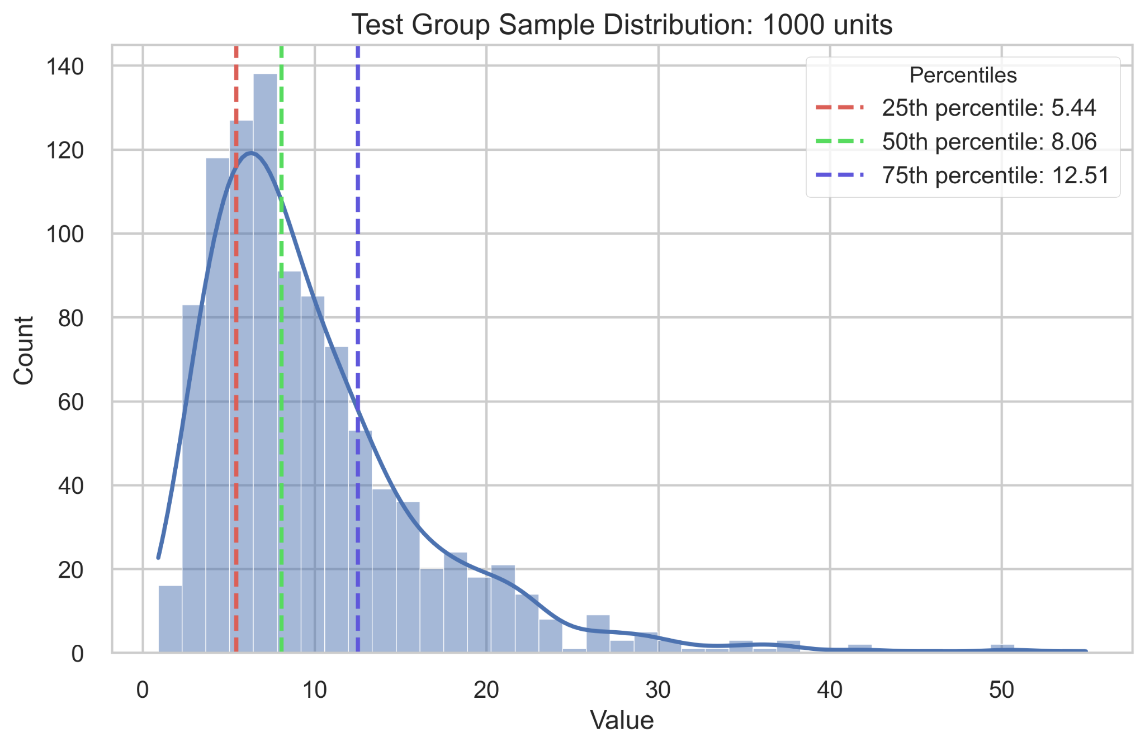

Statistical Criteria Applicability and FPR (1)
Repeat it in MC 🔁
Your criteria
P-value, CI
vs
Aggregate
~ Alpha

Slide 8
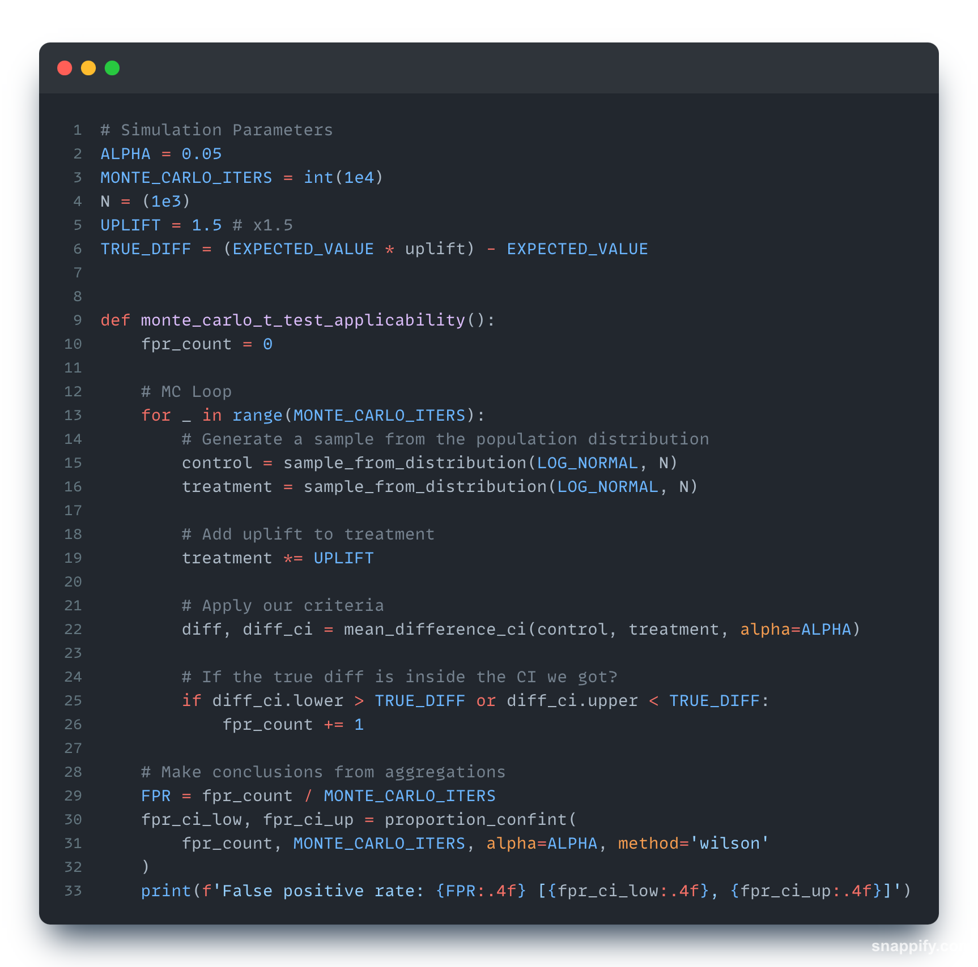
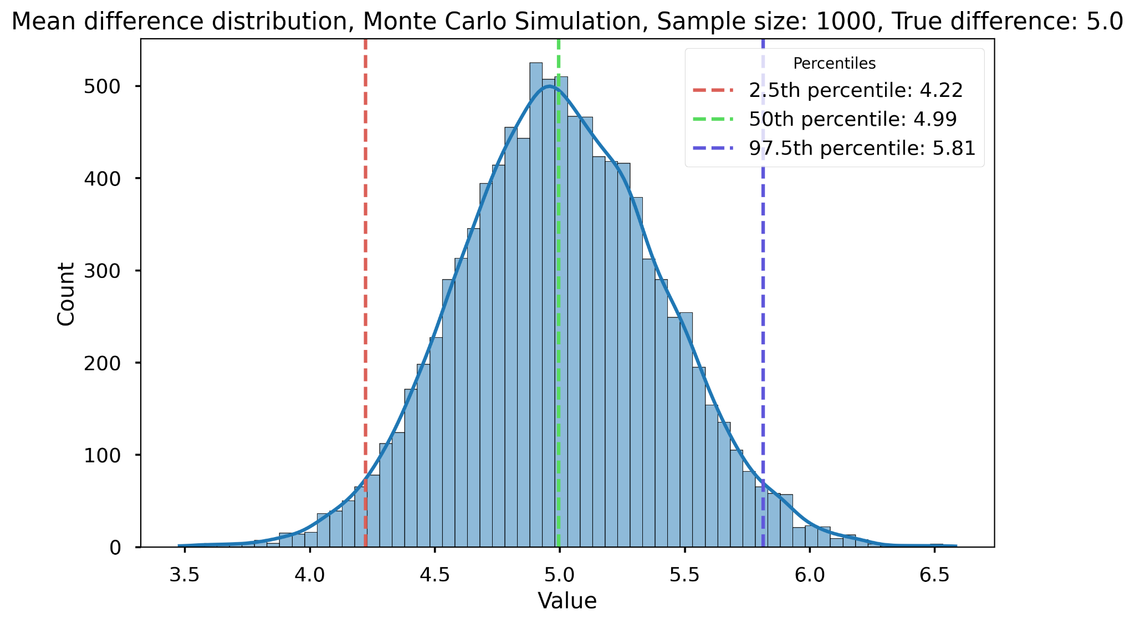
T-test applicability check, example
Some random realization CI
In 95% of the cases our criteria will have the CI which includes True Difference
T-test works perfectly with Log-normally distributed data if sample size = 1000
We can experiment on sample size to test Central Limit Theorem boundaries.
Output: False positive rate: 0.049 [0.046, 0.052]

Slide 9
Testing criteria applicability pro tips:
Measuring FPR and Power is better than validating criteria assumptions separately.
Calculate CI for FPR and Power based on the number of MC iterations
Simulate AA tests with known effect size and check if the test can estimate the true difference.
Try different distributions, sample sizes, and effect sizes. Model your real data, but also try to break it with corner cases.
Rule of thumb: FPR > alpha means underestimation of statistics variance, issues with core assumptions. FPR < alpha means underpowered test, the CI is too wide, the test is too conservative.
Output: False positive rate: 0.049 [0.046, 0.052]

Slide 10
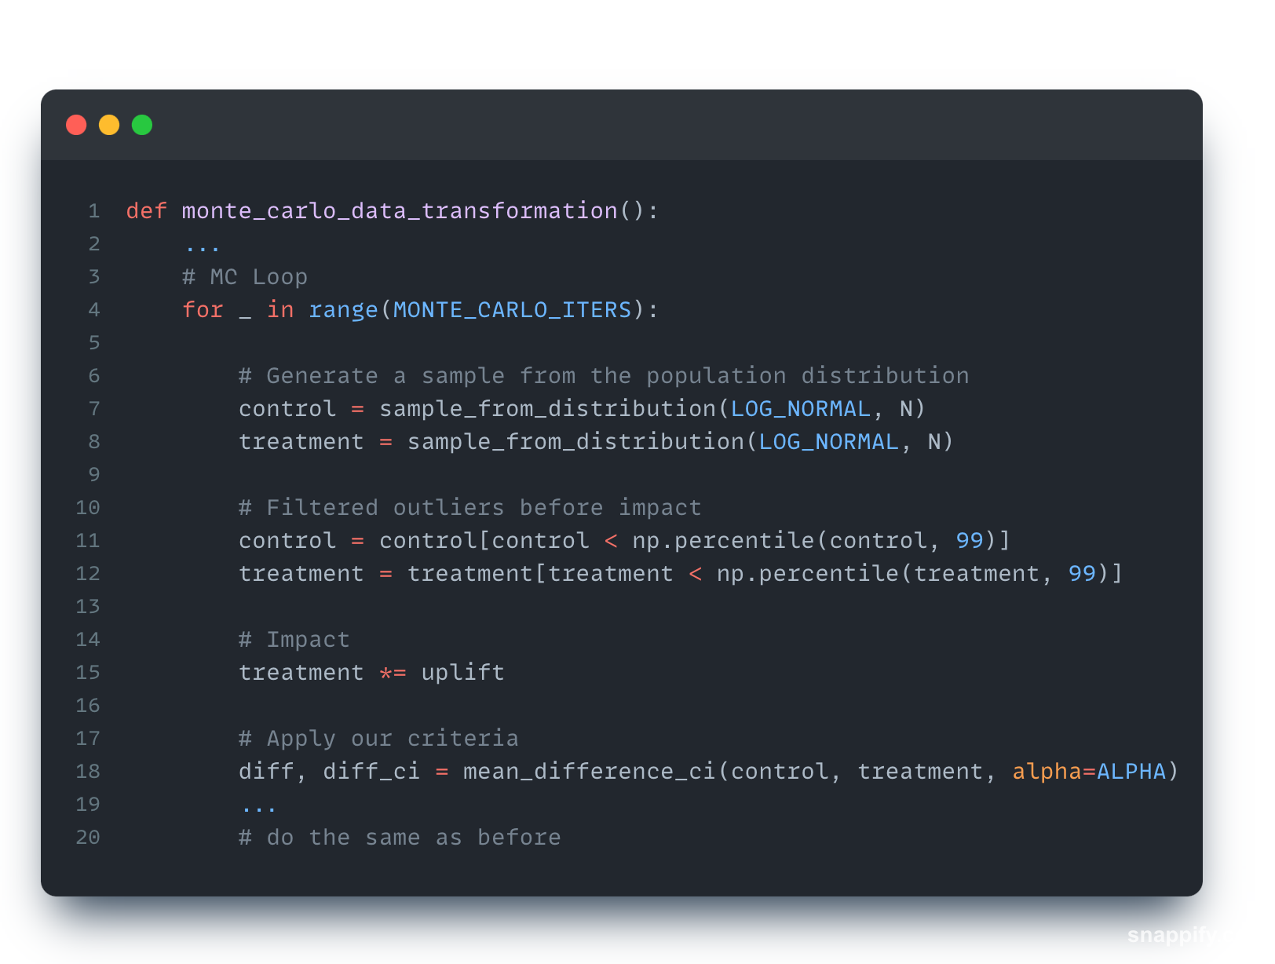
Monte-Carlo is not only about statistical criteria
We decided to filter outliers to reduce noise in data

Slide 11
Monte-Carlo is not only about statistical criteria
My Framework is not valid anymore? What happened?
False positive rate: 0.0748 [0.0698, 0.0801]

Slide 12
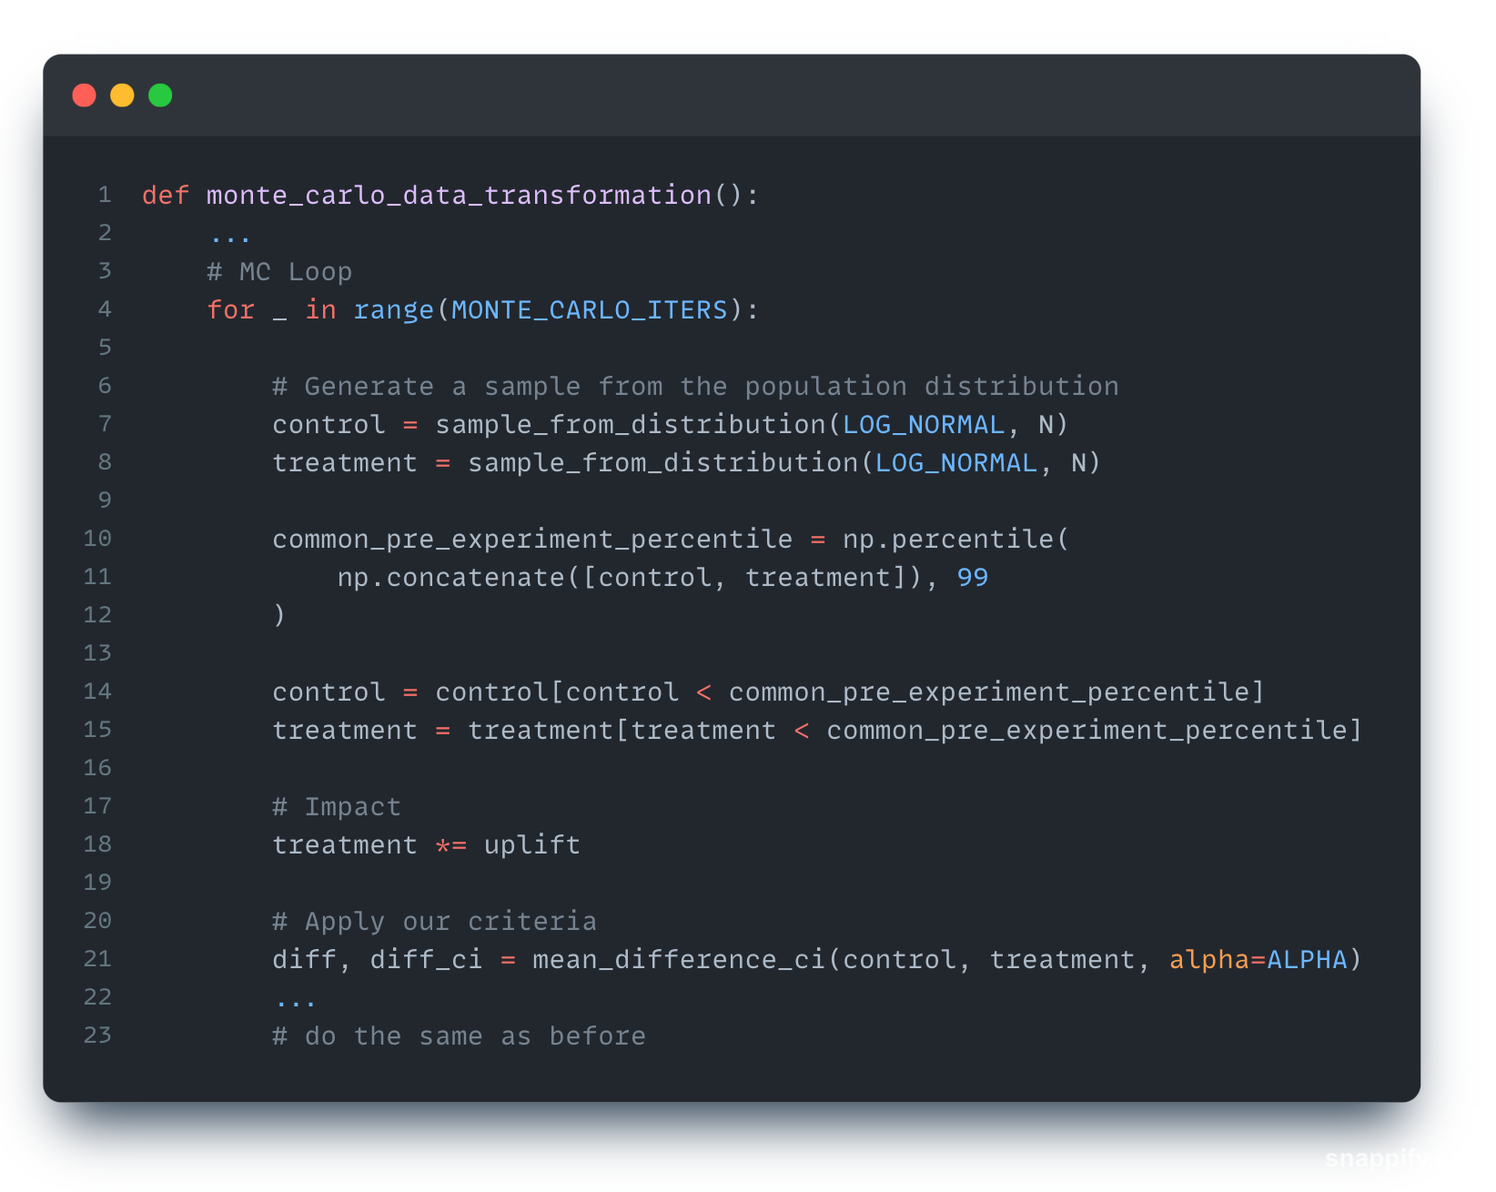
Monte-Carlo is not only about statistical criteria
Filter based on the same value *don’t forget to use pre-period
Unbalance groups with different filtering value
False positive rate: 0.0748 [0.0698, 0.0801]
False positive rate: 0.0510 [0.0469, 0.0555]

Slide 13
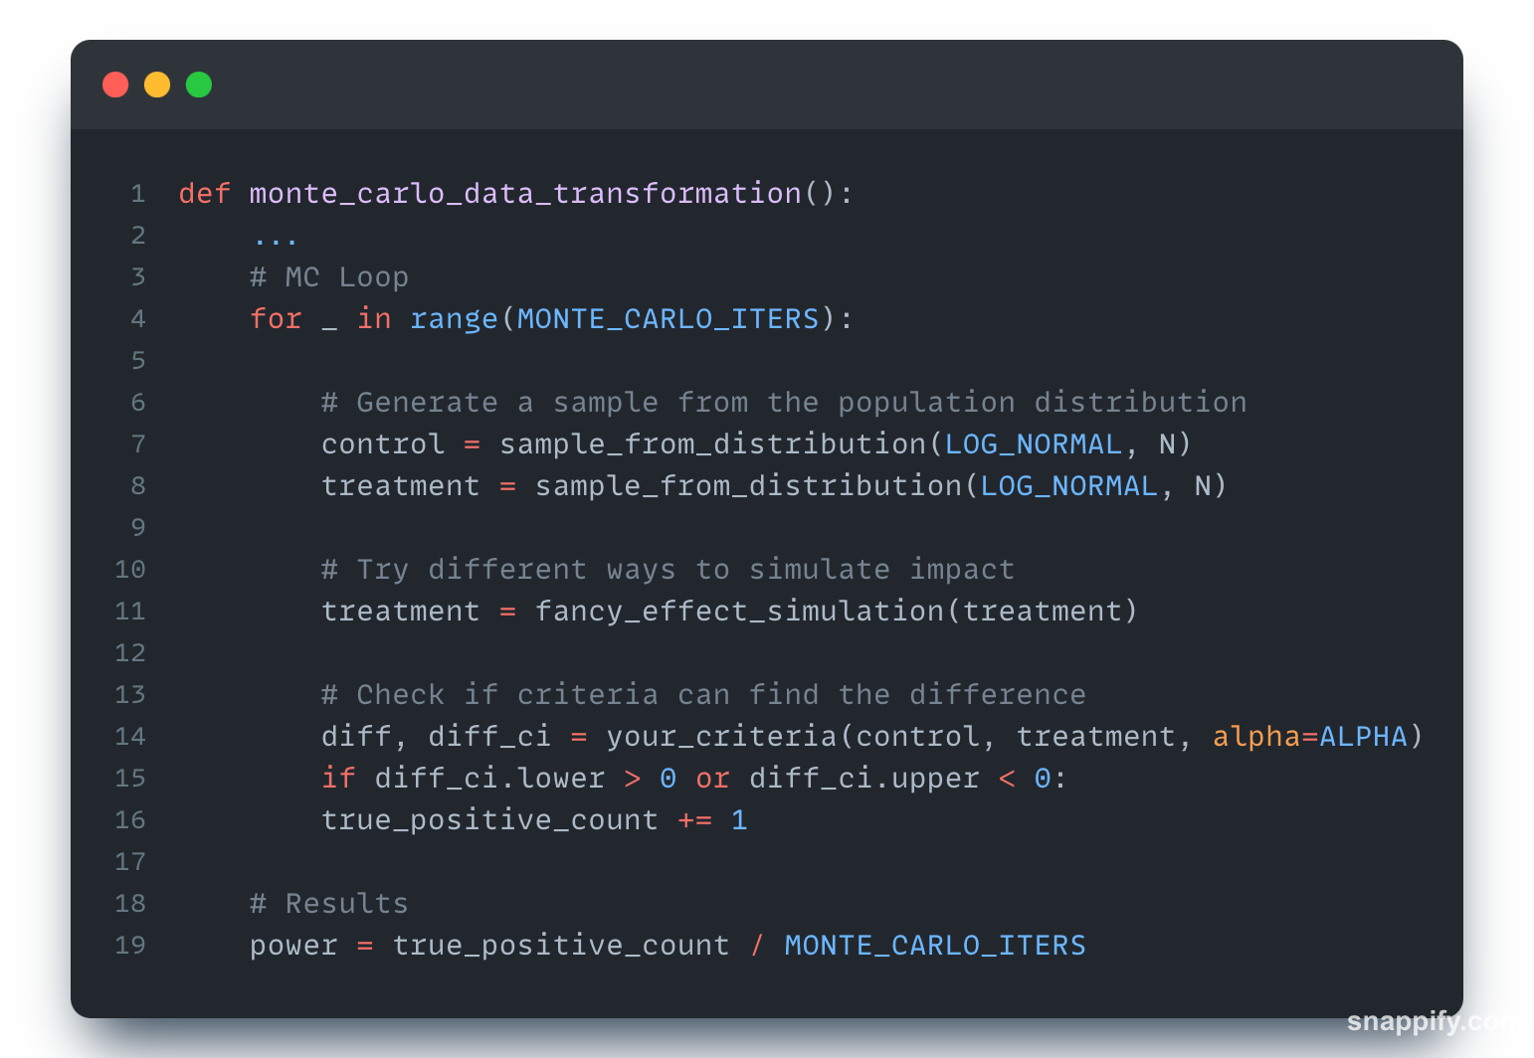
Scratching the surface of the Power analysis
Power: 0.23
FPR is “static” check
Power is a measurement for the set of parameters

Slide 14
`
Check FPR
Measure
and compare
Power
Play
With
Params
⇲

Slide 15
Final thoughts
Monte-Carlo simulation is an ultimate validation tool. You can be very creative and test many parts of your framework.
Monte-Carlo gives a perfect sandbox to feel the frequentist theory and how statistics works.
You are not sure about the math? Simulate it and reverse engineer the problem
Do not hesitate to experiment with new methods and challenge solutions!
When does the CLT kick-offs for your distribution?
What if we somehow create a correlation between test and control to try paired statistical criteria?
Does sequential testing performs better if I peek only a handful of times and use Bonferroni correction?

Slide 16


Github
with code and more examples
LinkedIn
Networking

